Slide 1

Chapter 2
Teachers Discovering Computers
The World Wide Web

Slide 2
Chapter Objectives
Describe the World Wide Web portion of the Internet
Explain how Web documents are linked to one another
Explain the use of Web browser software
Explain how to use a Web search tool to find information
Identify several types of multimedia products available on the Web
Describe the educational implications of the Internet and the World Wide Web
Describe different ways to connect to the Internet and the World Wide Web
Describe the pros and cons of Web 2.0 tools for teachers and students

Slide 3
The World Wide Web
Started in the early 1990s
Hyperlinks
Uniform Resource Locator (URL)
Hypertext transfer protocol

Slide 4
World Wide Web (cont.)
The World Wide Web, or simply Web, consists of a worldwide collection of electronic documents, Web pages, organized into Web sites
It is made up of three main parts.
Backbone
Internet
Cloud
Client
Server

Slide 5
World Wide Web - Addressing
The Internet Protocol Address or IP Address
  Known as the dotted quad xxx.xxx.xxx.xxx
  Number that uniquely identifies each computer or device connected to Internet
Domain Name is the text version of IP Address
www.amazon.com = 207.171.166.252

Slide 6
World Wide Web - URL
The Universal Resource Locator (URL) - Unique address for a web page located on a specific web server

Slide 7

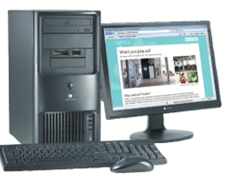

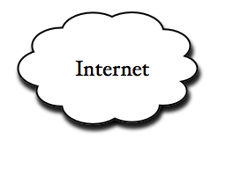
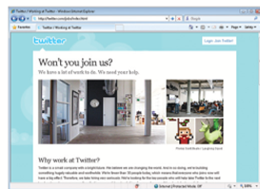
World Wide Web - URL (cont.)
Twitter
server
Jobs
protocol
http://twitter.com/jobs/index.html
http://twitter.com/jobs

Slide 8
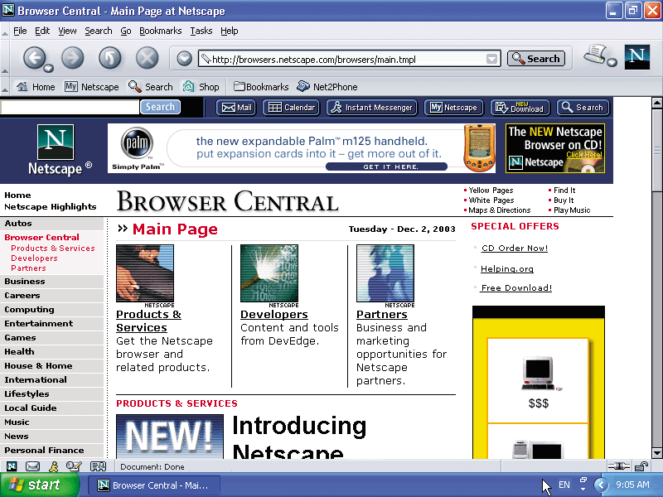
The Web Page
Web pages consist of three components;
  Text
  Multimedia
    Graphics
    Audio
    Video
  Hyperlinks

Slide 9
Hyperlinks
Text or graphics that connect (link) to other web pages.
Three types of links
  Items found elsewhere on the same page
  Different web pages in the same site.
  Other web sites.
Hyperlinks can be text or graphics

Slide 10
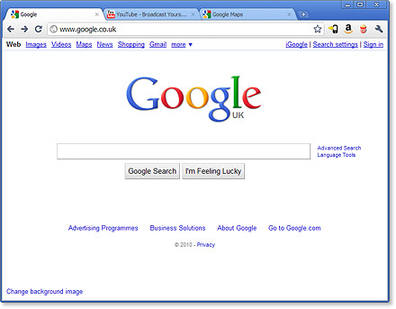
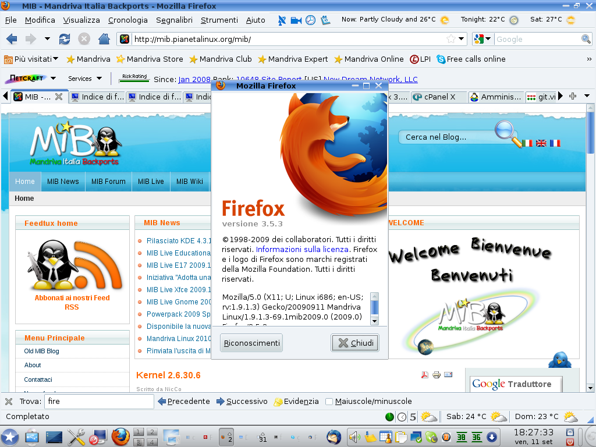
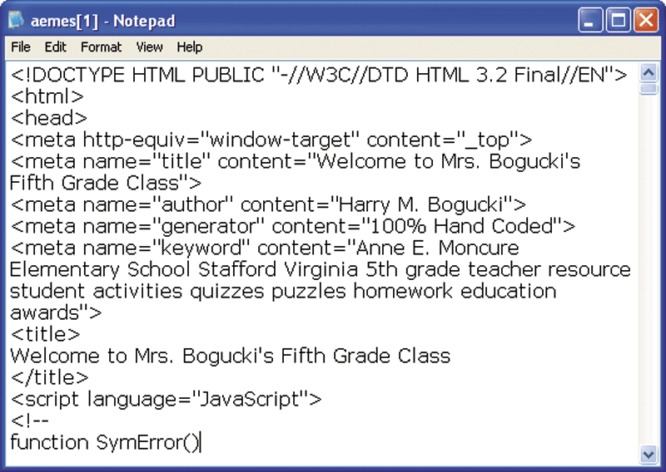
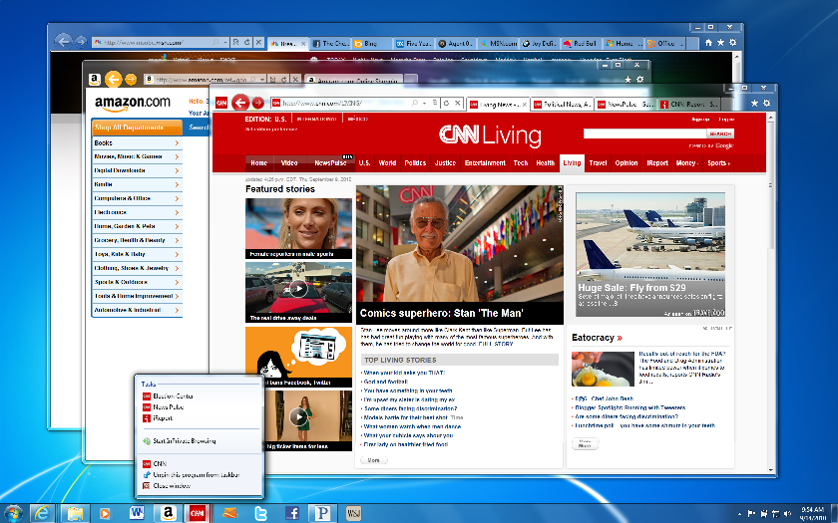
The Web Browser
Web Browser Software
  Interprets HTML, displays Web pages and enables you to link to other Web pages and Web sites
The most popular browsers are;
  Internet Explorer 9
  FireFox
  Google Chrome

Slide 11
The Web Browser (cont.)
Web browser software have sub-systems that can help increase your efficiency when working on the internet, they include;
  History
  Bookmarks or favorites
  Tabs

Slide 12
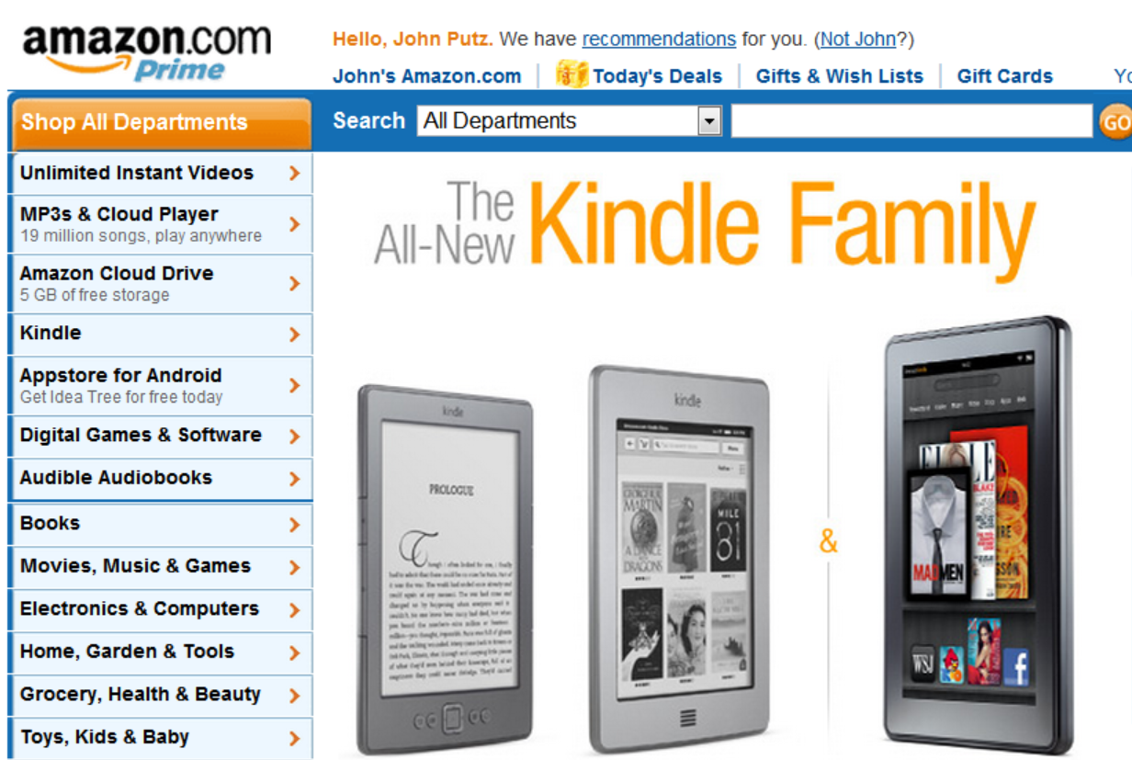

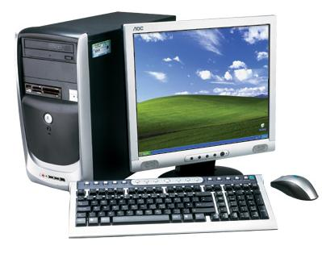

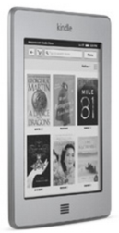

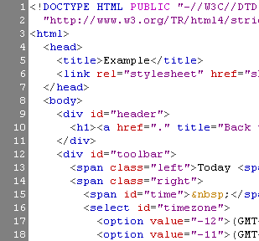
Downloading
The process of transferring information for a server to a client
www.amazon.com

Slide 13
Downloading
Downloading information can be effected by a number of variables;
  Type of Internet connection
  ISP
  Time of day and day of week
  Amount of information to be downloaded.

Slide 14
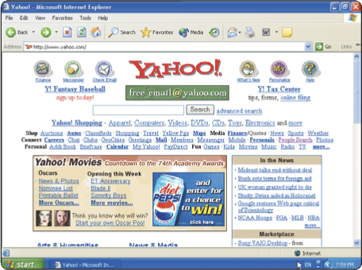
Categories of Web Sites - Portal
A Web site that offers a variety of services from one, convenient location, usually for free

Slide 15
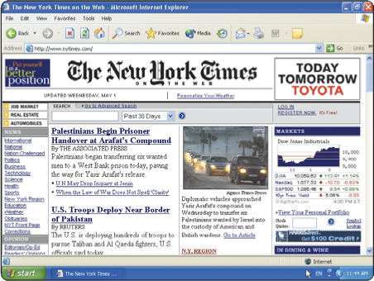
Categories of Web Sites - News
Contains newsworthy material
Stories and articles relating to current events, life, money, sports, and weather
News Archives

Slide 16
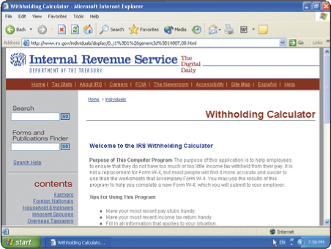
Categories of Web Sites - Informational
Contains factual information
Created by organizations and government agencies
Make sure that the web site is legitimate

Slide 17

Categories of Web Sites - Advocacy
An advocacy Web site contains content that describes a cause, opinion, or idea. These Web sites usually present views of a particular group or association.

Slide 18
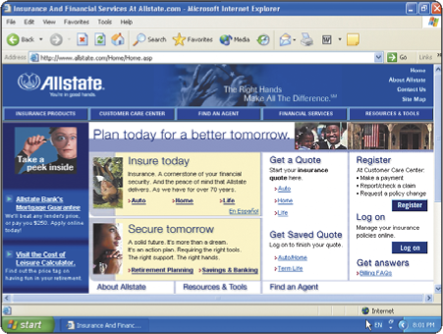
Categories of Web Sites – Business
Contains content that promotes products
Allows you to purchase products or services online
Allows companies to purchase goods and service from other companies

Slide 19
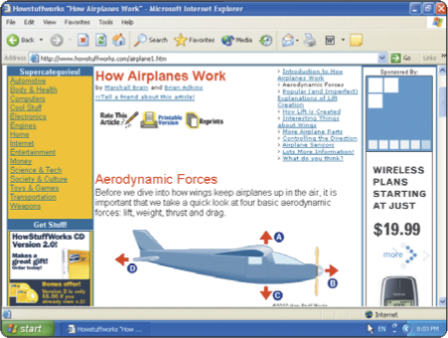
Categories of Web Sites – Education
Offers avenues for formal and informal teaching
and learning
Colleges offer
online classes and
degrees
Some companies
offer online training
for employees

Slide 20
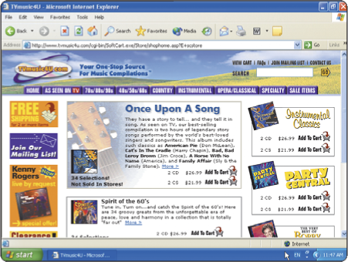
Categories of Web Sites – Entertainment
An entertainment Web site offers an interactive and engaging environment.
Popular entertainment Web sites offer music, videos, sports, games, ongoing Web episodes, sweepstakes, chats, and more.
Sophisticated entertainment Web sites often partner with other technologies.

Slide 21
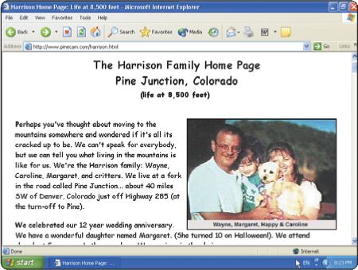
Categories of Web Sites – Personal
Web page maintained by private individual
Reasons: sharing life experience with the world or job hunting

Slide 22
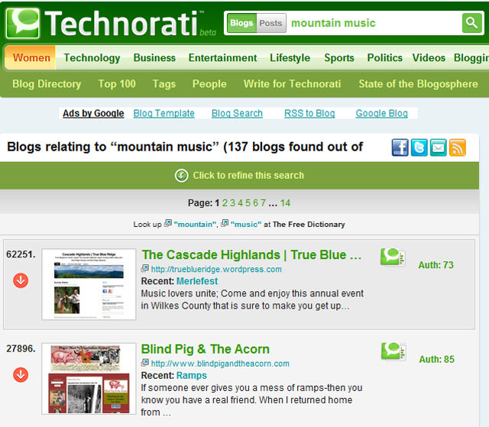
Categories of Web Sites – Blog
A blog, short for Weblog, is an informal Web site consisting of time- stamped articles, or posts, in a diary or journal format, usually listed in reverse chronological order.
A blog that contains video clips is called a video blog, or vlog.

Slide 23
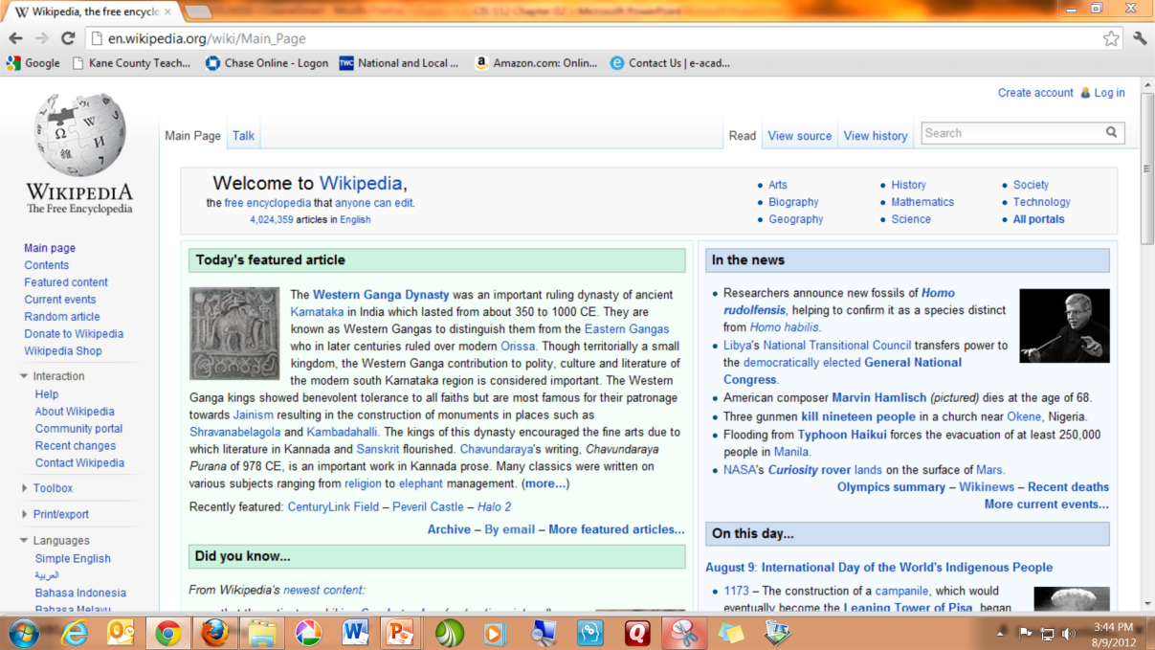
Categories of Web Sites – WIKI
A wiki is a collaborative Web site that allows users to create, add to, modify, or delete the Web site content via their Web browser.
Most wikis are open to modification by the general public.
A popular wiki is Wikipedia, a free Web encyclopedia.

Slide 24
Multimedia on the Web
  Web pages incorporate graphics, animation, audio, video, 3-D modeling, and virtual reality
  Plug-ins is a program that extends the capability of the browser.

Slide 25



Plug-ins
Acrobat Reader View - navigate, and print Portable Document Format ( PDF) files — documents are formatted to look just as they look in print
Flash Player - View dazzling graphics and animation, hear outstanding video, sound and music
Java - Enables Web browser to run programs written in Java, which adds interactivity to Web pages java. com

Slide 26




Plug-ins (cont.)
QuickTime - View animation, music, audio, video, and VR panoramas and objects directly on a Web page
RealPlayer - Listen to live and on- demand newscast, video, stream audio and video content
Silverlight - Experience high- definition video, high- resolution interactive multimedia, and streaming audio and video
Windows Media Player - Listen to live and on- demand audio, play or edit WMA and MP3 files, burn CDs, and watch DVD movies

Slide 27
Multimedia on the Web
Graphics
  Used to enhance text-based Internet
  Graphics formats
    Bitmap - BMP/. Bmp - Desktop background, scanned images
    Graphics Interchange Format - GIF/.gif - Simple diagrams, shapes, images with a few colors
    Joint Photographic Experts Group - JPEG/.jpg = Digital camera photos
    Portable Network Graphics - PNG/.png = Web graphics
    Tagged Image File Format -TIFF/.tif - Photos used by printing industry
Animation
  Marquees
  Animated GIFs

Slide 28
Multimedia on the Web (cont.)
Audio
  MP3, WAV, WMA, RealAudio, and QuickTime
  Streaming audio
  Podcasting
  RSS
Video
  Streaming video
Virtual Reality
  Simulation of real or imagined environment that appears as a three-dimensional (3-D) space
  VR worlds

Slide 29
The Impact of the Internet and the World Wide Web on Education
The Web is the Gutenberg printing press of modern times
Collaboration with other teachers and students
  ePALS
New instructional strategies

Slide 30
The Future of the Internet and the World Wide Web
The Web will continue to evolve as the primary communications channel for people around the world
By 2014, more than two billion wireless communication devices will be in use worldwide, and many of these products will have the ability to access the Web wirelessly
Devices that use embedded computers, such as automobiles, will have built-in Internet access capabilities
Web search capabilities will be more intelligent and focused. Within a few years, the Web will operate at speeds 10,000 times faster than today

Slide 31
The Future of the Internet and the World Wide Web
Apps and Tablet Computers
  Sales of tablet computers will exceed the overall sales of desktop and notebook computers in the next few years
  Sales of apps will replace many current application software programs as education software quickly morphs into thousands of education apps
  Many schools, districts, and states will create their own standards-based education apps for use by teachers, students, and their parents

Slide 32
The Future of the Internet and the World Wide Web
Many students will be using note taking apps, like Note Taker HD, which is an app for writing and organizing handwritten notes and diagrams on a tablet computer
Education apps will target specific learning styles, aptitudes, and abilities. Apps will revolutionize the ability of schools to educate students with disabilities
Education apps and tablet computers may indeed measurably increase student achievement (including test scores) and could do it quickly

Slide 33
The World Wide Web
Searching for Information on the Web
  Directory maintained by a search engine company
  Helps find information on the Web
  Search engine
  Subject directory

